Slide 1
Parsing Concepts: First, Follow, LL(1) and LR(0)
Abu Hanzala Walid Hasan Anamika Hossain
211-15-4022 213 –15- 4275 213-15-4246
Mamunur Rashid Anik Hasan Rifat
213-15-4556 213-15- 4267
Course Code: CSE331
Course Title: Compiler Design

Slide 2
Table of Contents
1. First and Follow
3. Rules for Follow Set
4. Example for First and Follow
5. LL(1) Parsing
6. Lr(0) Parsing
7. LL(1) and LR(0) Comparism
8. Conclusion
2. Rules for First Set

Slide 3

First and Follow
First(X): For a grammar symbol X, First(X) is the set of all terminals that can appear as the first symbol in any string derivable from X.
Follow(X): For a non-terminal X, Follow(X) is the set of all terminals that can appear immediately to the right of X in any sentential form.
Why it's Important?
Top Down Parsing
Bottom Up Parsing

Slide 4
Rules for First Set
If X is a terminal, First(X) = {X}.
If X -> ε (epsilon, empty string) is a production, ε is in First(X)

Slide 5
Rules for Follow Set
If there is a production A -> αXβ, then everything in First(β) except for ε is in Follow(X).
If there is a production A -> αX or A -> αXβ where β =>* ε (β derives the empty string), then everything in Follow(A) is also in Follow(X).

Slide 6
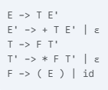
Example for First and Follow
First(E):
E -> T E'
First(E) = First(T) = First(F) = { (, id }
Follow(E):
E -> T E'
Follow(E) = First(E') = {+, ε}
Since E' can derive ε, Follow(E) also includes Follow(E') = Follow(E) = {+, $}
Therefore, Follow(E) = {+, $}

Slide 7
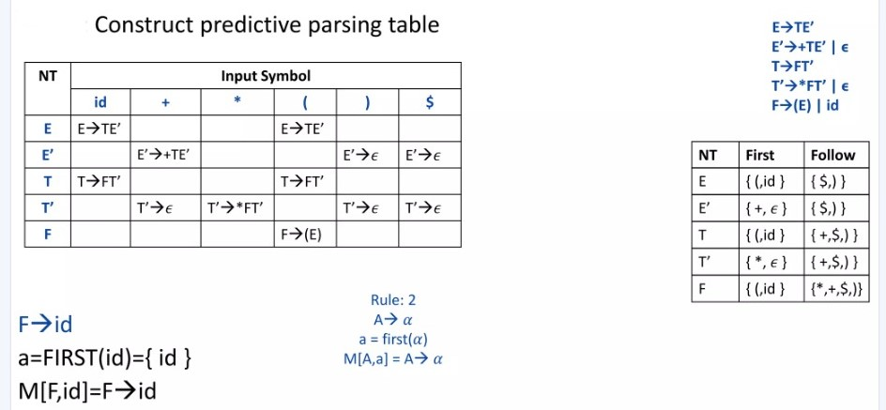
LL(1) Parsing Table

Slide 8
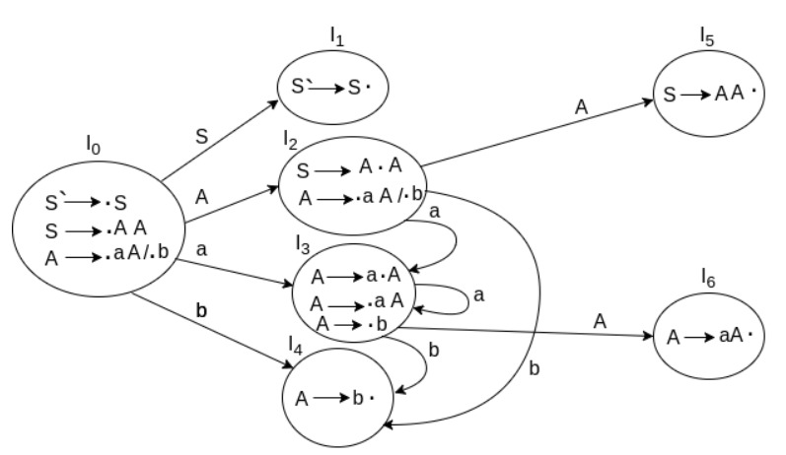
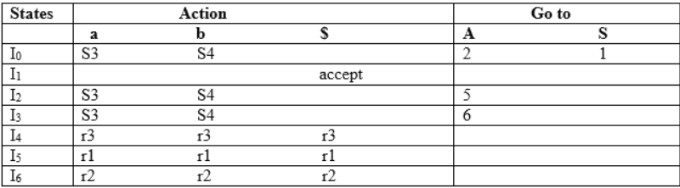
Lr(0) Parsing

Slide 9
LL(1) and LR(0) Compares
LL(1) Parser:
First L of LL is for left to right and second L is for leftmost derivation.
It follows the left most derivation.
Using LL parser tree is constructed in top down manner.
In LL parser, non-terminals are expanded.
LR(0) Parser:
L of LR is for left to right and R is for rightmost derivation.
It follows reverse of right most derivation.
Parser tree is constructed in bottom up manner.
In LR parser, terminals are compressed.

Slide 10

Conclusion
FIRST and FOLLOW sets help build predictive parsers.
LL(1) is for top-down parsing, requires no ambiguity.
LR(0) is for bottom-up parsing, uses state machines.

Slide 11
Thank You

